Slide 1


SOUNDEC
HMI Audio IC Provider
*HMI： Human-Machine Interaction

Slide 2






Company Profile
Company Name: SOUNDEC Technology Co., Ltd.
Addrees: Changhong Technology Building, Nanshan
District,Shenzhen
Establishment period: March 2017
Capital: RMB 19.286 million
Company Name: SOUNDEC (Nanjing) IC Technology Co., Ltd.
Address: High-tech Industry Service Center, Science City,
Pukou District, Nanjing
Establishment period: May 2019
Capital: RMB 20 million
Partner
Confidential

Slide 3




Audio entrance form is showing a diversified trend, and the application scenarios of audio chips are becoming more and more extensive.
Smart
Home
Headset
Smart
Phone
Car
Special
Industry
Audio processing chip
Global shipment of smart speakers, smart TVs, robots, smart wear and other products will exceed 1 billion units in 2021
Nearly 1 billion headsets will be shipped globally in 2021, of which more than 600 million wired headsets; more than 300 million TWS headsets
Global shipment forecast in 2021 is 1.38 billion units
Worldwide shipments of abPower out 80 million vehicles in 2021
Industrial Noise Isolation & Hearing Protection Hearing Aid & Specialty Industries
Soundec provides comprehensive audio signal processing solutions in human-computer interaction scenarios
Confidential

Slide 4
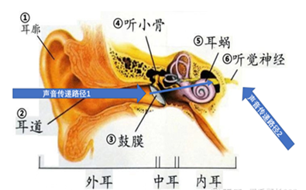
Multimodal Audio Algorithms，Form the unique core technology advantage of Soundec
EVC（Ear canal Voice Capture）
Echo Cancellation
Beam Forming
ENC
AGC
Exclusive ear canal pickup method
Implement unique features
Clear call in strong noise environment
Even in a 100dB noise environment
Also enables unobstructed clear calls
“Ventriloquistlike ”Audio Pickup
Exclusive worldwide In ordinary environments, it is possible to achieve unobtrusive Whispering"private" calls(Especially suitable for SWAT, security personnel and other special purposes)
Timbre correction
Bass Boost
Dynamic EQ
Spatial Audio
Loudness
In-ear detection
Breathing & heartbeat detection
Confidential

Slide 5
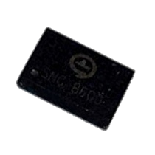
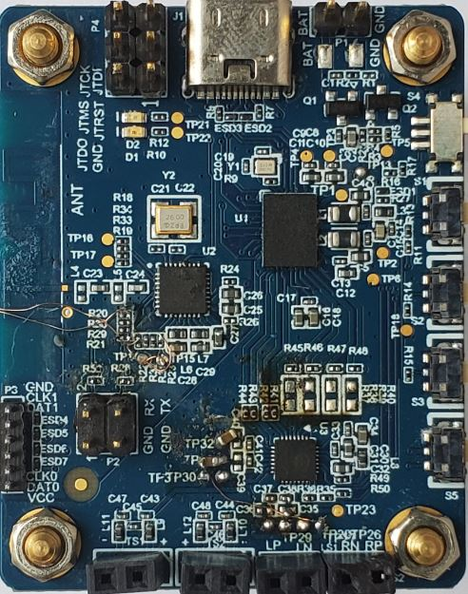
First Generation Audio Chip Architecture
PMU
DVDD
Regulator
AVDD
Regulator
POR
BOR
Mic
Bias
DSP
Core
Stereo
DAC
DAC-L
RAM
ROM
DAC-R
50mm
Stereo
ADC
AMIC-L
SNC8600
Flash
OTP
SNC8600: CODEC SOC
BGA80：6.2 x 4.5 x 0.5 mm
BGA63：5.0 x 3.5 x 0.5 mm
AMIC-R
ADC
Auxiliary
HW
Accelerator
DMIC
Processing
DMIC-x
30mm
TSMC 40nm Process
AHB-Bus
Clock Management
USB HS
Audio
Type-C
I2S
I/F
I2C
I/F
UART
I/F
GPIO
I/F
JTAG
I/F
Oscillator
PLL
Confidential

Slide 6
Audio Chip Specification Summary
key system functions
Name | Audio CODEC SOC including Type-C
Process | TSMC 40nm uLP
DSP | Cadence HiFi3 up to 200MHz
RAM | 512KB( iRAM 256KB,dRAM 256KB )
Flash | 1MB
Support Mic | Analog Mic 2pcs Digital Mic 6pcs
I/O | I2C | 2pcs
 | I2S | 3pcs
 | USB2.0 HS/FS | 1pcs
 | UART | 1pcs
 | ADC | 2pcs
XTAL | 24MHz
Sampling rate | 24bit/192K
Packaging | BGA80 Pin 6.2*4.5mm BGA63 Pin 5.0*3.5mm
key performance indicators
Power consumption(5V supply, 30MHz, 48KHz)
USB stereo music Playback | 87.5mW
USB call | 82.2mW
I2S music playback | 48.5mW
I2S call | 57.5mW
Suspend By USB | 0.5mW
ADC input Path(24bit,48KHz)
SNR | 95dB
DR | 106dB
THD+N | -88dB
DAC Power output Path(32Ω,24bit,48KHz)
SNR | 100dB
DR | 106dB
THD+N | -80dB
Confidential

Slide 7
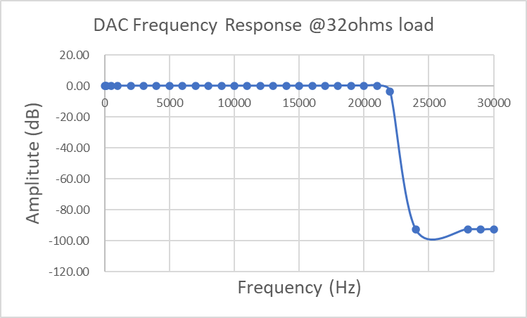
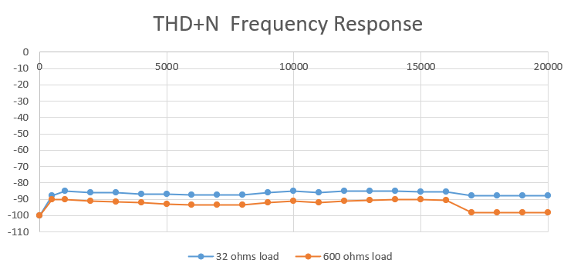
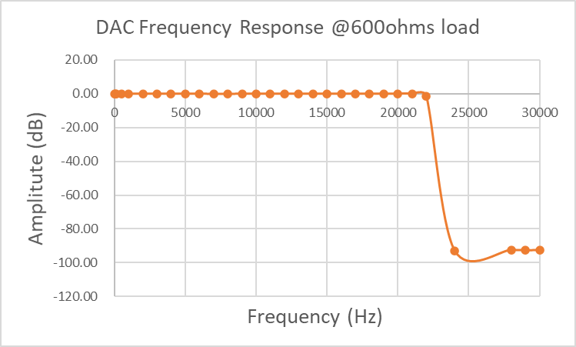
Performance
Test Conditions：
Input Signal Sample Rate：48Ksps
DAC Analog Gain：+0dB
DAC Digital Gain：0dB
Impedance：600Ω and 32Ω
Confidential

Slide 8
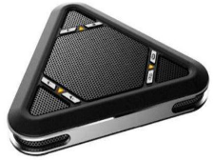
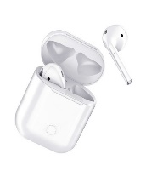
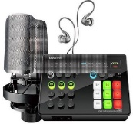
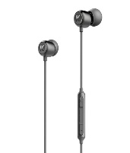
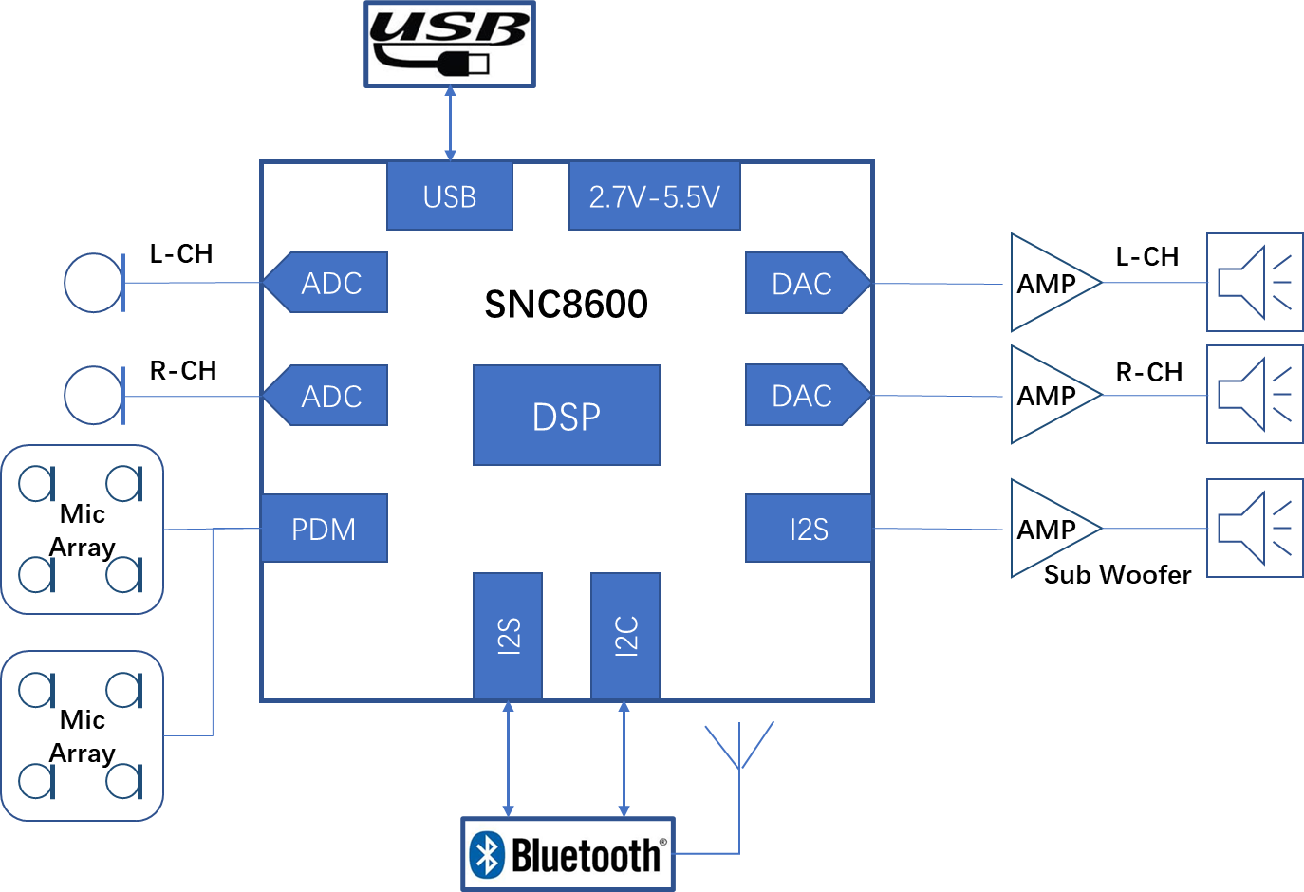
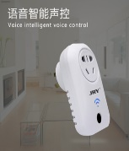
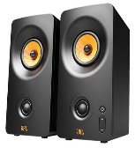
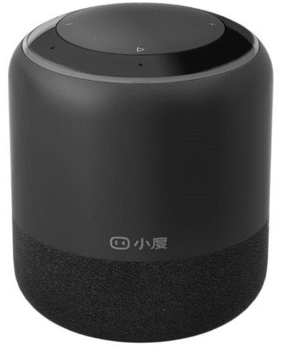

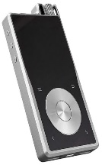
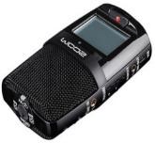
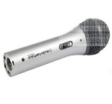
Application Scenarios of Audio Chips
Conference
Speaker
BT Earphone
Mixer
Type-C Earphone
AIoT
Speaker
Car
AI Speaker
Audio Player
Recorder
Microphone
Confidential

Slide 9
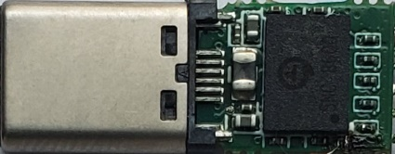
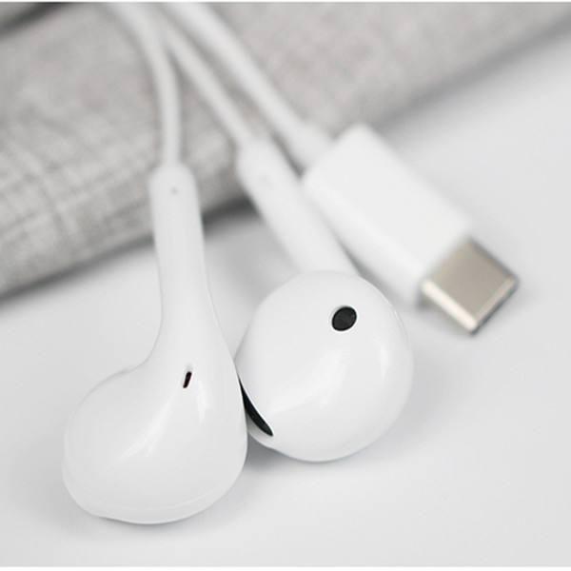
Solution Introduction ① Type-C Earphone Module
Main parameters
Core Technologies
Dynamic EQ
Rich music playback effect
13.5mm
8.0mm
Product form | Type-c Earphone plug Module
I/F | Type-C
SR | 24bits /192KHz
Mic Product form | AMIC/DMIC
Power out | 1Vrms@16Ω/ 2Vrms@32Ω
THD | <0.0015%
DR | 110dB
SNR | 100dB
24.5mm
Features
Bass boost
Mid-high frequency dynamic balance adjustment
Call noise reduction
Improve the consistency of the left and right speakers of the earphone
Confidential

Slide 10
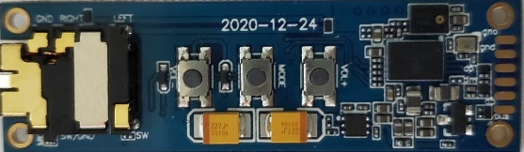
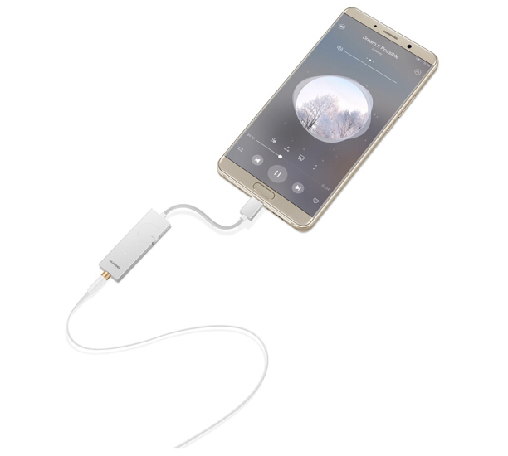
Solution Introduction ② Headphone Amplifier
Features
Timbre correction
Bass Boost
Dynamic EQ
Loudness
Multiple play modes
Music
Game
Theater
Main parameters
Produc form | Headphone Amp / Adapter
I/F | Type-C/Lighting o 3.5mm Audio Jack
SR | 24bits /192KHz
Power out | 1Vrms@16Ω/ 2Vrms@32Ω
THD | <0.0015%
DR | 110dB
SNR | 100dB
Confidential

Slide 11
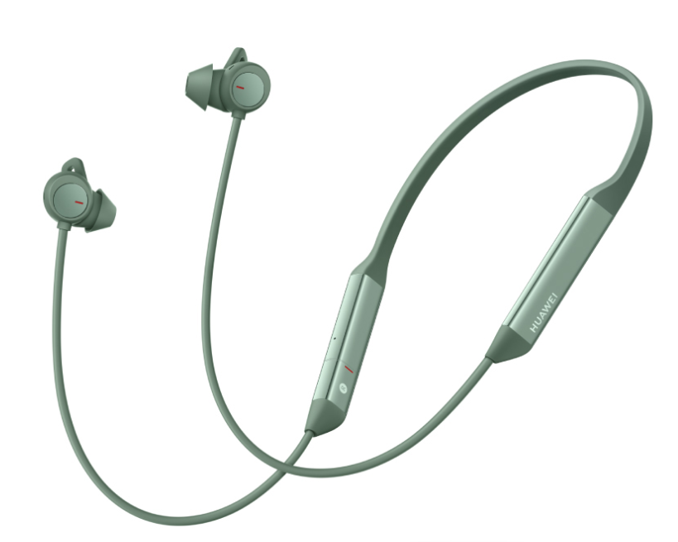
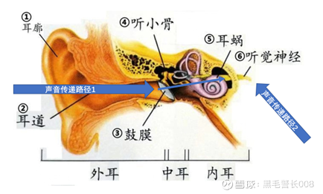
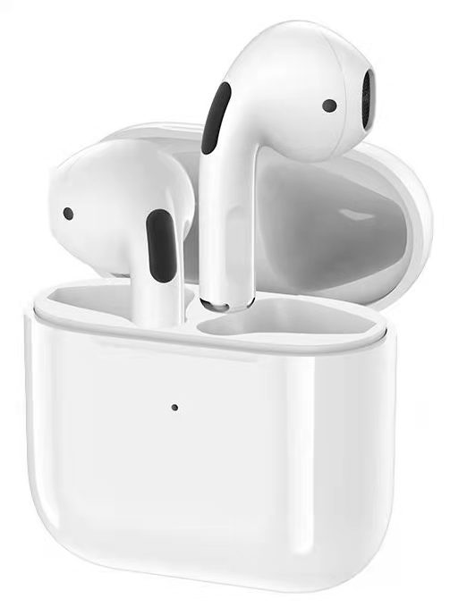
Solution introduction ③ Super Anti-Noise Earphones
Core technologies
・EVC（Ear canal Voice Capture）
Features
Super Noise Immunity
(Ambient Noise + Wind Noise) Ambient noise above 85dB, strong wind (15m/s)
Whisper
Spatial audio
Main parameters
Product form | Single ear／TWS／ Neck hanging
Type | In-Ear
NR Depth | 20dB
Power out | 1Vrms@16Ω / 2Vrms@32Ω
Harmonic Distortion
 | <0.0015%
DR
 | 110dB
SNR
 | 100dB
Confidential

Slide 12
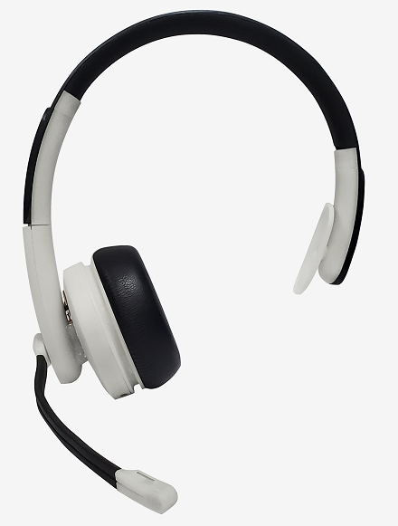
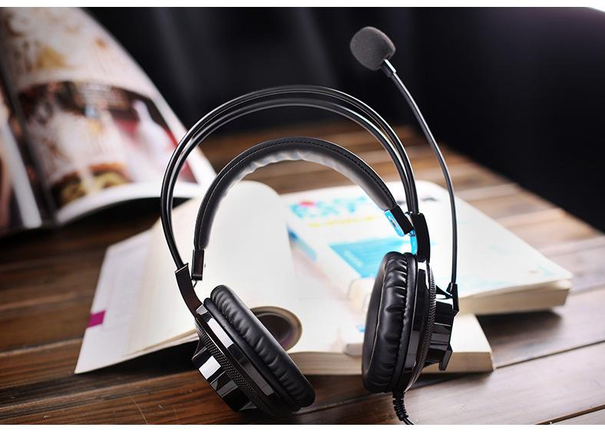

Solution introduction ④ Noise-cancelling Headset
Core technologies
（ENC）
90dB ambient noise for clear calls
Noise reduction depth 30dB
Main parameters
Product form | Headset
I/O | USB or BlueTooth
MICs | 2pcs
Application scenarios | Operator Gaming Examination Learning Conference
Confidential

Slide 13
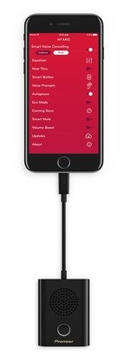
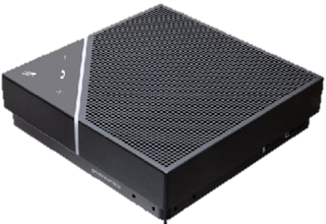
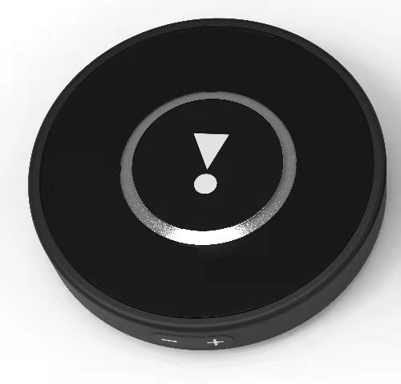
Solution introduction ⑤ Conference Speaker
Main parameters
Product form | Conference speaker
Support MICs | 1 or 2 or 4 or 6pcs
Pickup distance | 1m、2m、3m、5m
Support Speaker power | 2W、3W、5W
I/F | Type-C
Application scenarios | Conference Online class
Core technologies
・AEC（Full duplex）
・AGC
・ENC
・Beamforming
Confidential

Slide 14
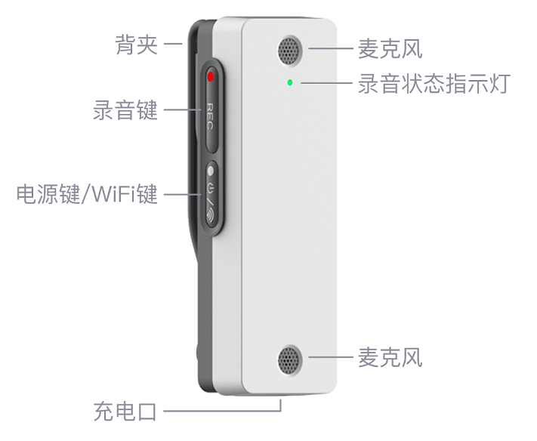
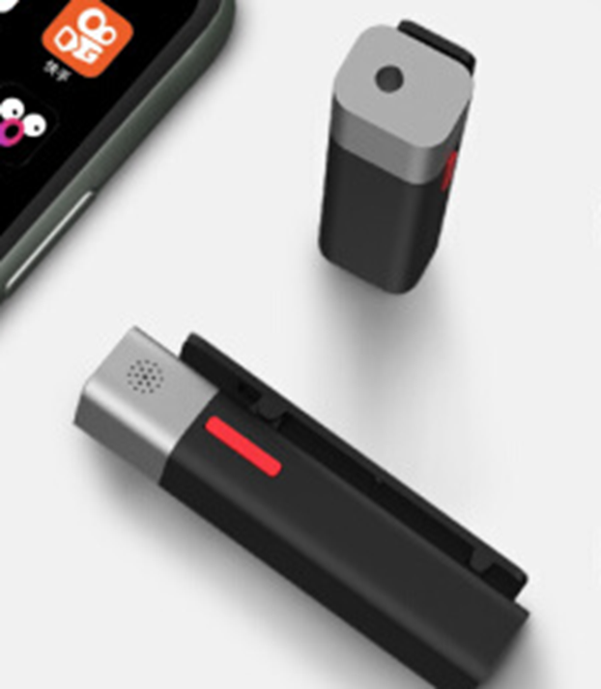
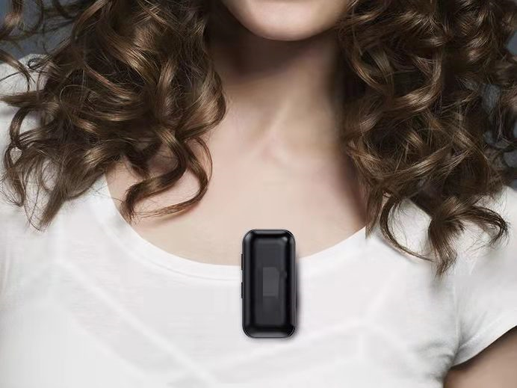
Solution introduction ⑥ Recording Pen／Wireless Microphone
Main parameters
Core technologies
・High fidelity recording
・AGC
・ENC
・Beamforming
Product form | Recording Pen／Wireless Microphone
MICs | 2pcs
Pickup distance | 2m
Audio format | wav/mp3/opus
Transfer method | Wi-Fi / BLE / USB
Application scenarios | Interview Live streaming Speech Recording
Confidential

Slide 15
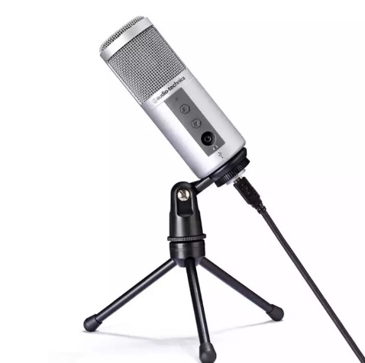
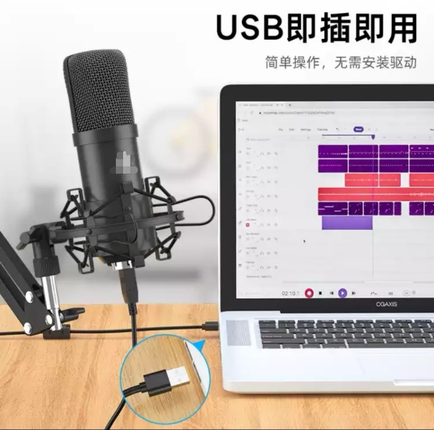
Solution introduction ⑦ USB MIC
Main parameters
Core technologies
・ High Fidelity Power output
・AGC
・AEC
・ENC
Product form | USB MIC
MICs | 1 or 2pcs
Pickup distance | 2 - 3m
Audio format | wav/mp3/opus
Transfer mode | USB
Application scenarios | Interview Live streaming Conference
Confidential

Slide 16
Product Planning
First Generation Audio IC Type-C
Second Generation Audio IC Type-C
Third Generation Audio IC
Type-C & BT
Headset
EVC
AEC/AGC/ENC
24bit/192KHz
Beamforming
EVC/ENC
AEC/AGC/ANC
Call noise reduction
Smail Size / Low power
EVC/ANC/ENC
24bit/192KHz
Beamforming
22nm
Add bluetooth
Ultra low power
IC/Module Sales
Smart Home
Smart Classroom
Smart Office
IC+MIC Array
IC+MIC Array
IC+MIC Array
2-4 MICs
Beamforming
Noise suppression
6 MICs
Echo suppression
Far field pickup
8 MICs 、AGC
Intelligent Noise reduction
Echo cancellation
voice wake up 、Far field pickup
Sound source localization 、Adaptive Filter
Module Sales
Healthy
Hearing aid
Adaptive Filter
Howling suppression
Ai environment Noise reduction
IC& Solution
Special
Industry
(Talkie Walkie)
ENC Earphone Kit
AEC & Adaptive Filter
Super Ambient Noise Cancelling Calls
Wind Noise Suppression
Module Sales
2021年Q4
2022年Q1
Q2
Q3
Q4
2023Q1
1st STEP
2nd STEP
Business Model
Confidential

Slide 17
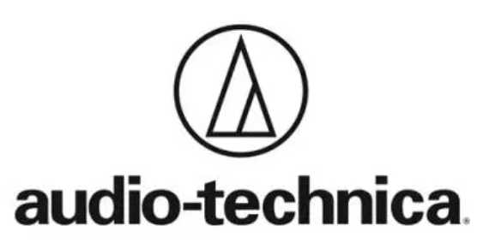









Partner
立讯精密
Confidential

Slide 18
Thanks！

